Slide 1
Capstone Project on The Adult Income Dataset
Name : Adarsh Lokhande
Degree : Bachelor of Technology
Passout : 2021

Slide 2

Agenda
INTRODUCTION
FEATURE INFORMATION
EXPLORATORY DATA ANALYSIS
FEATURE SELECTION
MODEL BUILDING
MACHINE LEARNING ALGORITHM
ENSEMBLE TECHNIQUES
DECISION ALGORITHM
COMPARING PARAMETERS
CONCLUSION

Slide 3
INTRODUCTION
Problem Statement :TEXT HERE
The goal of this machine learning project is to predict whether a person makes over 50K$ per year or not given their demographic variation.
This Data Set Contains 32561 Instances and 15 features that are a mixture of categorical, ordinal, and numerical data types.
Source : https://archive.ics.uci.edu/ml/machine-learning-databases/adult/
Git Hub : https://github.com/AdarshLokhande/Classification-Analysis-Adult-Income-Dataset-/blob/main/Adult%20Analysis.ipynb

Slide 4
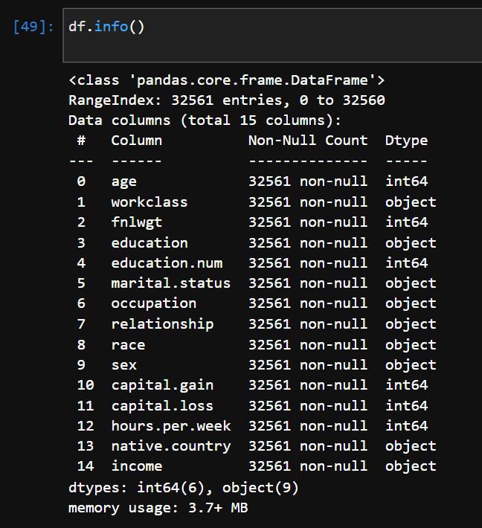
Here is the set of variables contained in the data
age
workclass
fnlwgt
education
education_num
marital
occupation
relationship
race
sex
capital_gain – Capital gains recorded
capital_loss – Capital Losses recorded
hr_per_week
country
INCOME – Boolean Variable

Slide 5
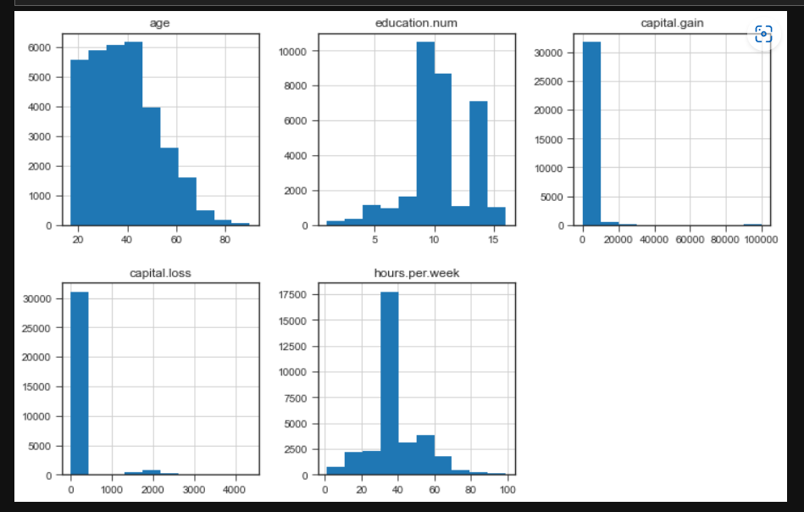
Exploratory data Analysis

Slide 6
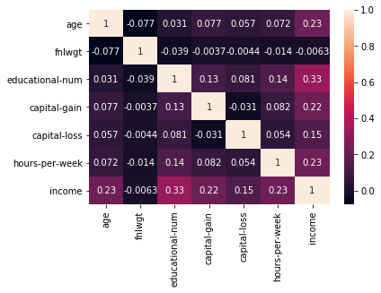

Slide 7
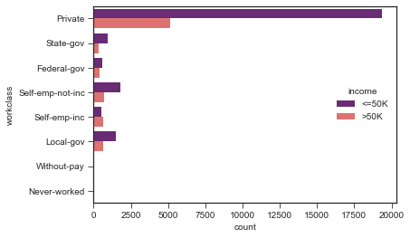
This plot is about workclass vs income and shows that private workclass get higher income than other workclasses.

Slide 8
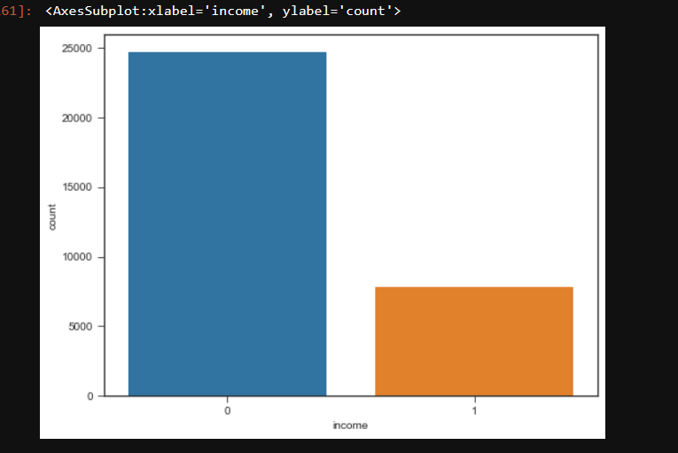
Target Variable Visualization

Slide 9
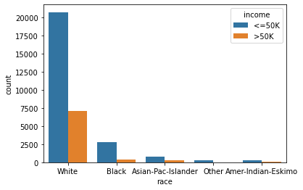
This count plot shows the graph race vs income. It clearly shows that white race get more income than the other race.

Slide 10
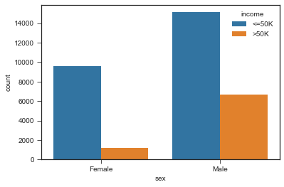
This is another observation from dataset , the countplot shows Sex vs income. It shows that Males are higher income than females.

Slide 11
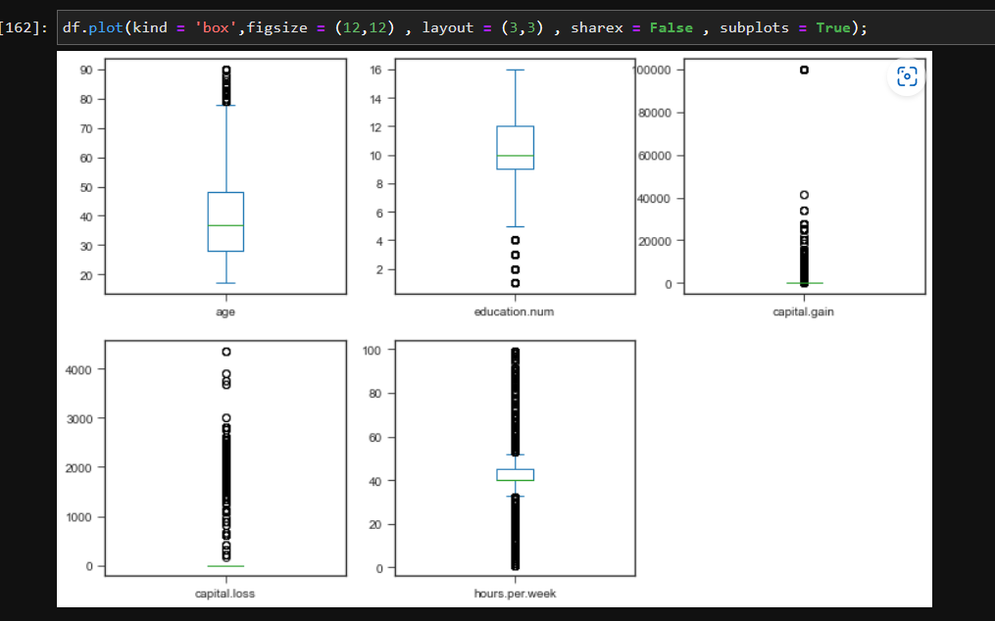
Visualization with the help of Box Plot

Slide 12
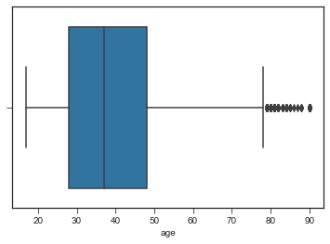
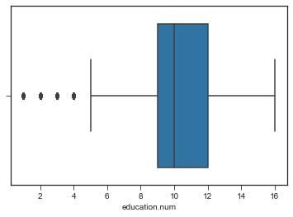
Box plot
Before handling outliers.

Slide 13
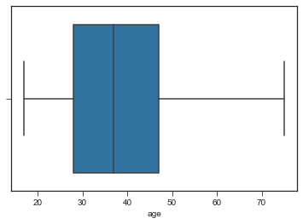
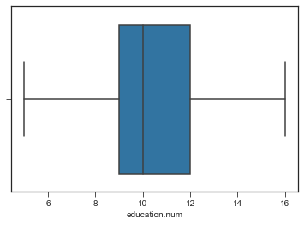
After Handling outliers.

Slide 14
Handling Categorical to Numerical
from sklearn.preprocessing import LabelEncoder
le = LabelEncoder()
# short way of applying encoder
df[df.select_dtypes(include = ['object']).columns] = df[df.select_dtypes(include = ['object']).columns].apply(le.fit_transform)

Slide 15
Data Standardization :
Using Standardization we have converted every entry between the range of mean = 0 and standard deviation = 1
We try to have a bell shape curved with normal distribution of our data
we performed standardization, because best fit line or curve is sensitive to new data points or outliers

Slide 16
Data Balancing :
We have 19775 records for class 0 [Income less than 50k$]
We have 6273 records for class 1 [Income greater than 50k$]
Techniques to handle Imbalanced Data:
Stratified Sampling
Oversampling
Undersampling
Over and Undersampling

Slide 17
Stratified Sampling :
x_stratified = final_df.iloc[:,:-1]
y_stratified = final_df.iloc[:,[-1]]
x_train,x_test,y_train,y_test=train_test_split(x_stratified,y_stratified,train_size=0.8,stratify=y_stratified,random_state=0)
Class 0 records for Training=19775
Class 1 records for Training=6273
Tranning ratio=3.14
----------------------------------------------------------------------------------------------
Class 0 records for Testing=4945
Class 1 records for Testing=1568
Testing ratio=3.14

Slide 18
Comparing results with oversampling and stratified samplings :
Algorithem name | Accuracies with oversampling | Accuracies with stratified sampling
Logistic regression | 73.3 | 80
KNN | 74 | 81.4
Dicission Tree classifier | 76.63 | 78.2
Random Forest classifier | 79.13 | 81.89

Slide 19
Comparing results with Accuracy and cross valiadation Accuracy :
Model | Accuracy | Hyper Parameter | Cross Validation
Logistic Regression | 0.80 | Penalty = 12 Solver = Newton-cg | 0.803
KNN | 0.814 | Metric = ‘ Minkowiski’ n_neighbours = 15 weights = uniform p = 1 | 0.82
Decision Tree | 0.782 | Criterion = entropy max_depth = 11 min_sample_split = 4 min_sample_leaf = 7 | 0.81
Random Forest | 0.80 | n_estimators = 95 criterion = entropy max_depth = 31 min_sample_split = 4 min_sample_leaf = 7 | 0.813

Slide 20
Model | Accuracy | Hyper parameter | cross validaton
Bagging | 0.78 | n_estimator = 51 bootstrap = True oob_score = True | 0.80
SVM | 0.785 | Degree = 4 | 0.81
AdaBoost | 0.813 | base_estimator = dt lr = 0.01 n_estimator = 25 | 0.837
XGBoost | 0.83 | max_depth = 5 min_child_weight = 1 | 0.84
Voting Classifier | 0.81 | - | -

Slide 21
Hypothesis by our own and its Applications of Model :
Goverment wants to launched new taxession scheme using machine learning and using this data. Goverments wants this scheme in favour of citizens.
If someone with income more than 50k if comes under class 0, and paying lower tax it is acceptable but someone with income less than 50k and still classify under class 1, it will nots be accepted.
So , our aim will be choosing model having,
Lower FPR
Higher accuracy
Higher Precission
. Government is ready to accept bit lower TPR

Slide 22
Choosing best fit model according to problem statement :
Name of model | FPR | PRECISION SCORE | ACCURACY | RECALL SCORE | ROC-AUC SCORE
Decision tree | 5.1 | 71 | 81 | 51 | 67
Random forest | 10.9 | 62 | 81 | 55 | 72
XGBoost | 8.5 | 69 | 84 | 60 | 74.8
Conclusion: According to problem statement XGBOOST CLASSIFIER MODEL seems to be performing well.

Slide 23
Thank you folks

